Slide 1
Buses and Bandwidth
Measuring the Process-Memory Gap
By : Keidrick Wooten & Austin Swaim

Slide 2
What are Buses?
Physical connections in a computer system that allows multiple hardware components to communicate with one another.
Main Types of Buses
Data Bus – Transfers actual data between components.
  Width (e.g., 8-bit, 16-bit, 32-bit) determines how much data can be transferred at once.
Address Bus – Carries memory or I/O addresses, telling the system where to read/write data.
Control Bus – Sends control signals (e.g., read, write, clock, interrupt) to coordinate operations.

Slide 3
What is Bandwidth?
The bandwidth of a bus refers to the maximum data transfer rate it can handle, which is determined by the bus width and the clock speed.
Bandwidth is crucial for various applications, including web hosting, video streaming, and file transfers, as it determines how quickly data can travel from the source to the destination.

Slide 4
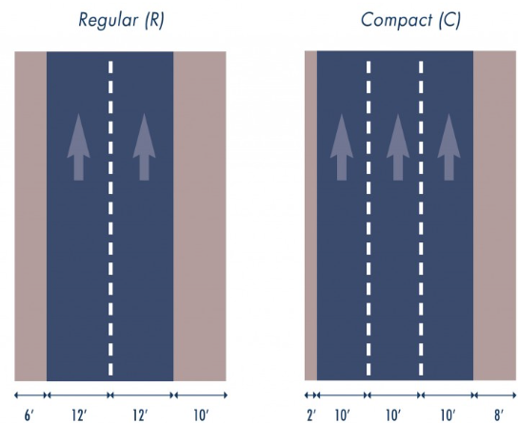
Analogy
Say for Instance we have a highway
The bus in this scenario is the number of lanes the highway has
The bandwidth in this scenario is the number of cars that can travel through the
Highway per hour
The clock frequency is the speed limit of the highway
This is exactly like an 8-bit vs 16-bit vs 64-bit memory bus.

Slide 5
What is the process memory gap?
The memory-process gap refers to the difference in speed between the processing capabilities of a CPU and the speed of memory.
This is crucial for memory management and performance optimization.

Slide 6
Why does this happen?
CPU Speed: 3–5 GHz (billions of cycles/sec)
Memory Speed: Much slower, only hundreds of millions of operations/sec
Result: CPU often waits for data which leads to stalling and lower performance
For example the Cpu is Super-fast sports car (300 mph)
While Memory is a Slow gas pump
The car spends more time waiting for fuel than driving.

Slide 7
Simulation Goal
Evaluate how:
Bus width (8-bit vs 16-bit)
Clock frequency (50–400 MHz)
affect effective bandwidth for different transfer sizes.
Transfer sizes tested:
16 B → 1 MB.
Colab Code - Colab

Slide 8
Citations
Barham, P., Dragovic, B., Fraser, K., Hand, S., Harris, T., Ho, A., et al. (2003). “Xen and the Art of Virtualization.” Proceedings of the 19th ACM Symposium on Operating Systems Principles (SOSP).
PDF: https://www.cl.cam.ac.uk/research/srg/netos/papers/2003-xensosp.pdf
NumPy Developers. “The N-dimensional array (ndarray).” NumPy Documentation.
https://numpy.org/devdocs/reference/arrays.ndarray.html
NumPy Developers. “numpy.array — Create an array.” NumPy Documentation.
https://numpy.org/doc/2.1/reference/generated/numpy.array.htm
Matplotlib Developers. Matplotlib Documentation.
https://matplotlib.org/stable/
Python Software Foundation. Python 3 Standard Library Documentation.
https://docs.python.org/3/library/math.html
McKinney, Wes. Python for Data Analysis: Data Wrangling with Pandas. O’Reilly Media, 2017.
https://pandas.pydata.org/docs/

